Slide 2
CONTENTS
Abstract
Introduction
Motivation
Tools and libraries
Objective
Methodology
Flow Chart
Timeline
References

Slide 3
MINOR-1 Image Segmentation
500076426 500076502 500075381 500075382 | R177219095 R177219080 R177219070 R177219100 | Jay Gupta Gaurav Sharma Dev Singh Ketan Chawla | CSE – AIML CSE – AIML CSE – AIML CSE - AIML
Under the guidance of
Prof. Goutam Datta
(Assistant Professor)

Slide 4
Abstract :-
.
Image segmentation is a vital step in image processing and is widely used in face recognition, object detection, autonomous cars, medical imaging, etc. There are different techniques to achieve image segmentation. Region-based, thresholding, edge detection and clustering are some of them. This project analyses and compares the results of these different image segmentation techniques.

Slide 5
Introduction :-
Image segmentation is the process of partitioning an image into different regions based on their features. Image segmentation has lots of application in different areas, like it is used in the face recognition technology which is used in security systems, image segmentation is used in object detection, in the medical science as a way to locate and identify fractures, damaged tissues and cells and also used in search engines that offers image-based searches.
There are different techniques through which image segmentation can be done. Following are some of them:
• Thresholding-based segmentation
• Region-based segmentation
• Clustering-based segmentation
• Edge detection-based segmentation

Slide 6
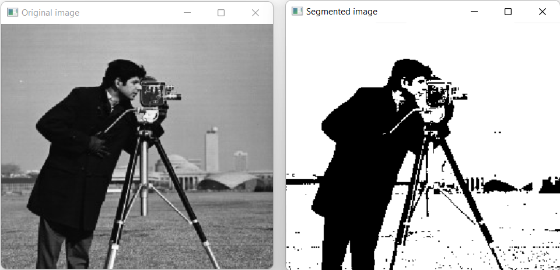
Thresholding Based Algorithm:
Otsu’s algorithm is a thresholding based image segmentation technique.
Based on the distribution of image pixel values, a threshold value is selected.
Two regions will be formed, based on this threshold value.
Result:

Slide 7

Clustering Based Algorithm:
K-means is a clustering based image segmentation technique.
Similar pixel values will be present in same cluster/region.
Result:

Slide 8
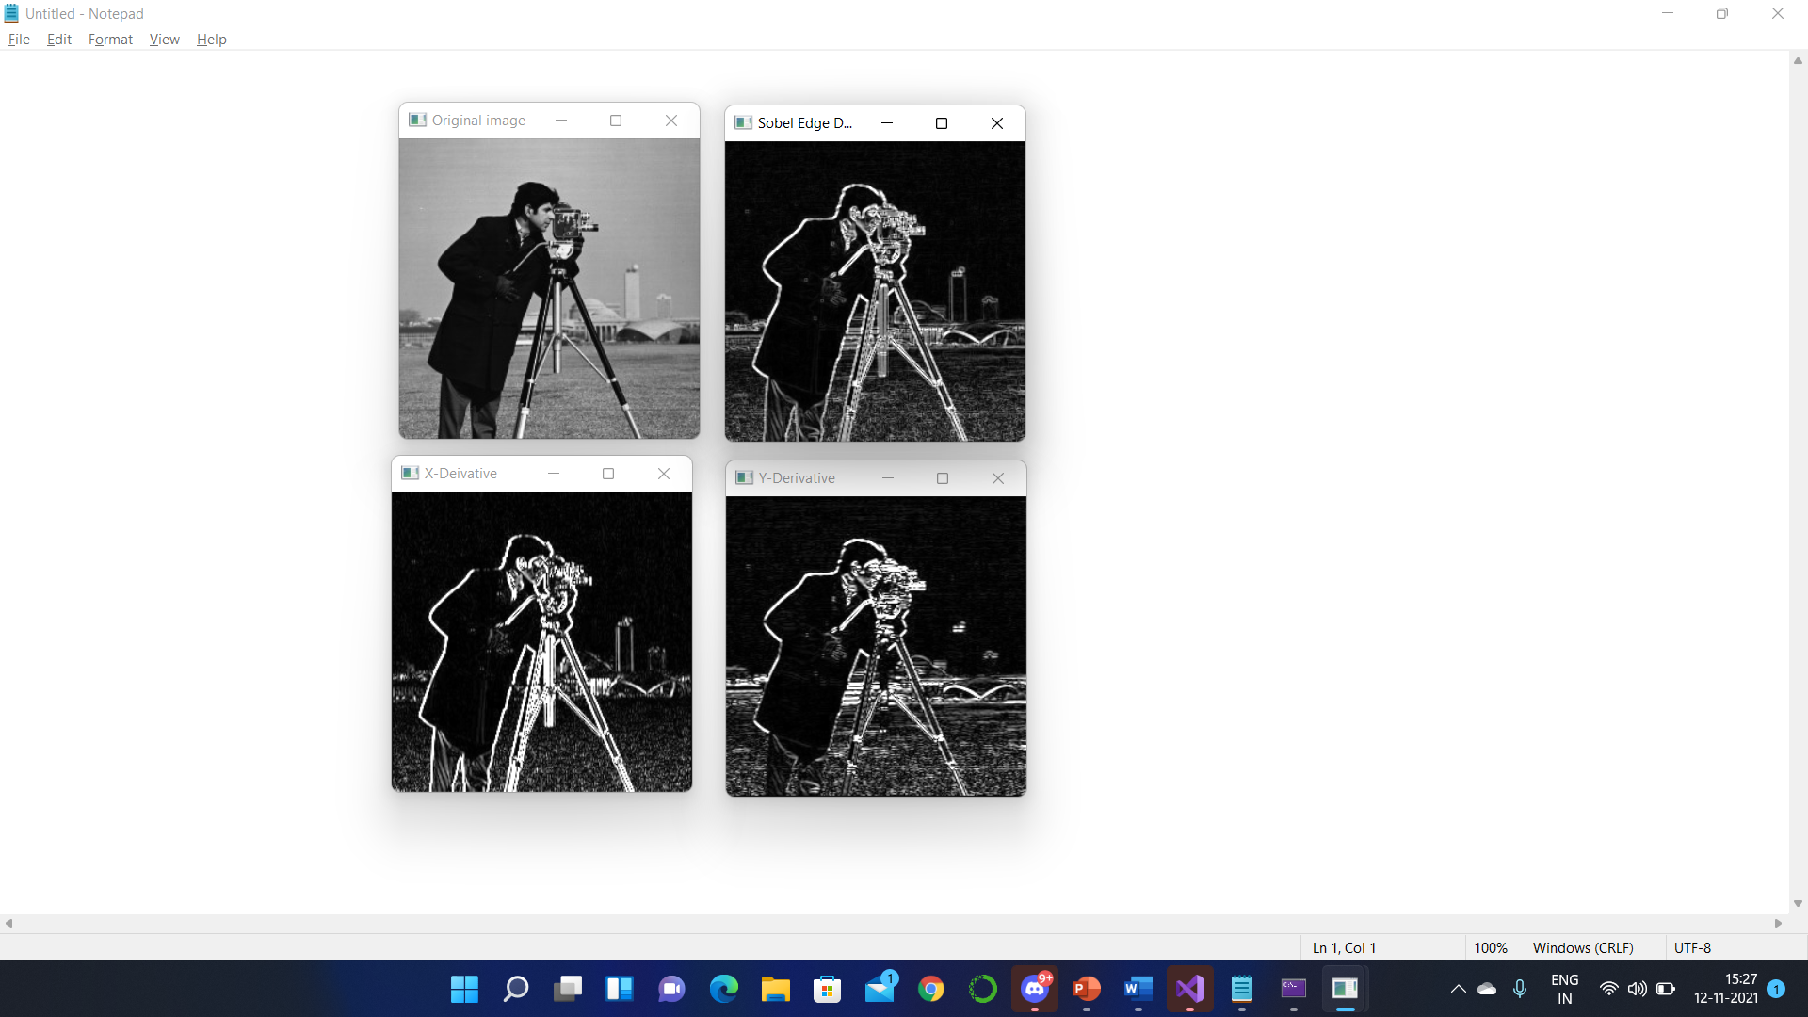
Edge detection:
Sobel operator is a edge detection operator.
It comprises of two 3x3 matrices, one to detect horizontal edge and the other to detect vertical edge.
This operator is applied on the pixels of the image to detect edges in it.
Result:

Slide 9
Region-Growing :
A seed point is selected
Then its pixel value is compared with its neighboring pixels
If values are close enough will be included into the region
And the process continues until region stop growing.

Slide 10
Motivation :-
Image processing especially image segmentation is used as a core technology in a large number of modern applications and systems. Image Segmentation plays an important role in the medical field. It is considered as the most important medical imaging process as it extracts the region of interest through an automatic process. Hence, we got the motivation to build a project on image segmentation as it is used to save billions of lives.

Slide 11


Tools and Library Used
Visual Studio
OpenCV

Slide 12
Objective :-
To compare the results of different image segmentation techniques on grey scale images.

Slide 13
Methodology :-
Study of different image segmentation algorithm
Comparing their results
Coding of algorithms
Merge all the algorithms

Slide 14
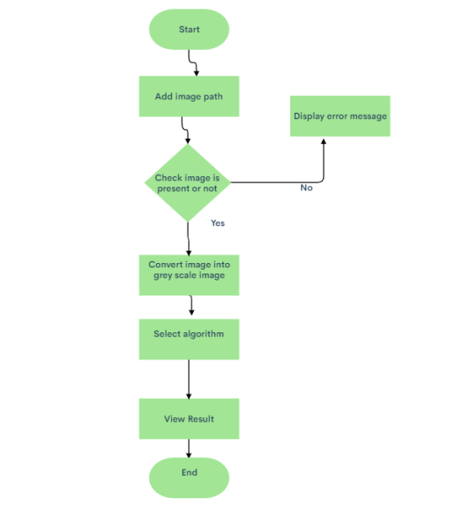
Flow Chart :-

Slide 15
Timeline
September | October | November
-Environment setup (installation of required libraries) -Understanding of working of different algorithms - Coding of k-means | -Coding of Otsu's image segmentation -Coding of edge detection -SRS creation | -Coding of region growing -Compilation of code

Slide 16
References :-
There is a research paper in which there is comparison of region-based segmentation. In this paper there is a comparison of two segmentation algorithm i.e., region growing and region merging.
Title: Region growing and region merging segmentation
Reference: https://ieeexplore.ieee.org/abstract/document/628077/references#references
There is a research paper in which there is comparison of every segmentation algorithm and find out how to combine these algorithms and use effectively.
Title: Image Segmentation Algorithms Overview
Reference: https://arxiv.org/abs/1707.02051
There is a research paper in which there is a comparison of each and every algorithm and finding the complexity, segmentation effect, flaws and improvements scope in those segmentation algorithms and also find which image is suitable for which algorithm.
Title: The Comparative Research on Image Segmentation Algorithms
Reference: https://ieeexplore.ieee.org/abstract/document/4959132
There is a research paper in which there is detail study of clustering segmentation.
Title: Clustering Techniques for Digital Image Segmentation
Reference:https://www.ijser.org/researchpaper/Clustering-Techniques-for-Digital-Image-Segmentation.pdf

